Slide 1

Linux Basics
Date: October 2023

Slide 2

Summary of Information Covered
Unix/Linux
History of Unix/Linux
Linux Shells
Linux Commands
Sample commands

Slide 3
Unix/Linux
Super Computers / Main Frame Servers
Dedicated servers or client workstations in a server-based network
Client/server workstations connected to a peer-to-peer network
Stand-alone workstations not connected to a network

Slide 4
Unix/Linux
UNIX/Linux is a multi-user system
UNIX/Linux is a multitasking system
Can execute more than one program at a time
UNIX/Linux is a portable operating system
Used in many computing environments

Slide 5
A brief history of Unix / Linux
Bell Labs originally developed UNIX in the late 1960s and early 1970s
Distributed in source code form
Universities modified the code to work on different machines
Two standard versions of UNIX evolved
System V (Bell Labs)
Berkeley Software Distribution (BSD)

Slide 6
A brief history of Unix / Linux
Unix had a unique structure.
Shell
The interface between user and OS
Hierarchical Structure
Directory and subdirectory organization
Essentially a collection of files

Slide 7
A brief history of Unix / Linux
Linux is UNIX-like
Not written from traditional UNIX code
Linux is original code
Uses same UNIX premise and design
Created by Linus Torvalds
Offers all the complexity of UNIX
Linux can coexist with other OSes
True Open Source Operating System

Slide 8
Linux Open Source
Open Source
Free Operating System or Software
Programmers have access to Source Code
Programmers can add features
Programmers can improve performance or fix bugs
Programmers can use code to create their own operating system or software
Multiple contributors means multiple versions
Some distributions (Distros) are managed by a governing group of volunteers (community)

Slide 9
Linux Open Source
Open Source
Free Operating System or Software
Programmers have access to Source Code
Programmers can add features
Programmers can improve performance or fix bugs
Programmers can use code to create their own operating system or software
Multiple contributors means multiple versions
Some distributions (Distros) are managed by a governing group of volunteers (community)

Slide 10
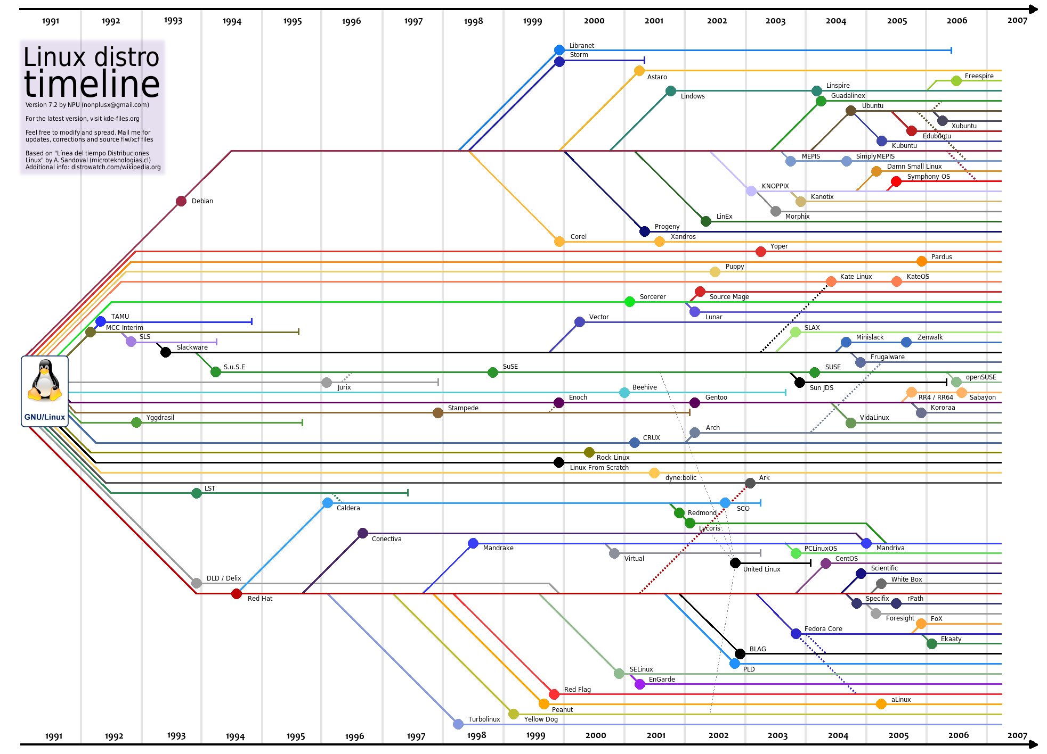
Linux Open Source
kde-files.org

Slide 11
Linux Shells
A shell is a Linux program that interprets the commands you enter from the keyboard
Shells interpret commands and act as programming languages
A default shell is associated with your account when created; Bash is the default shell in Linux
Additional shells: Bourne, Korn, C shell, Bash
Can switch from shell to shell
Users can connect (login) to a shell from a remote client
Users can use different shells at the same time

Slide 12
Linux Shells
Secure Shell (SSH)
Developed for Linux systems to provide authentication security for TCP/IP applications, such as FTP and Telnet
Can encrypt communications as they go across a network or the Internet
openSSH includes protocols and software for free distribution on UNIX/Linux systems

Slide 13
Linux Commands
Linux is a text based command based operating system
To interact with Linux, a command is entered at the command prompt
Linux is case-sensitive
most commands are typed in lower case

Slide 14
Sample Commands
date
Displays the system date, which the system administrator maintains
cal
Shows the system calendar
who
To get information about who is logged in
Useful for administrators and users
clear
Clears the screen
whatis
Displays a brief description of a command for help purposes

Slide 15
Sample Commands
sudo shutdown –r or sudo reboot
Restarts your current system
Sudo shutdown
Shuts down your current system
ls
Displays information about current directory
cd
Allows you to change your directory
cat
Displays content of a file to the screen

Slide 16

Questions

